Slide 1
The Sales And Profit Insights
File created on: 6/26/2024 2:02:27 PM

Slide 2
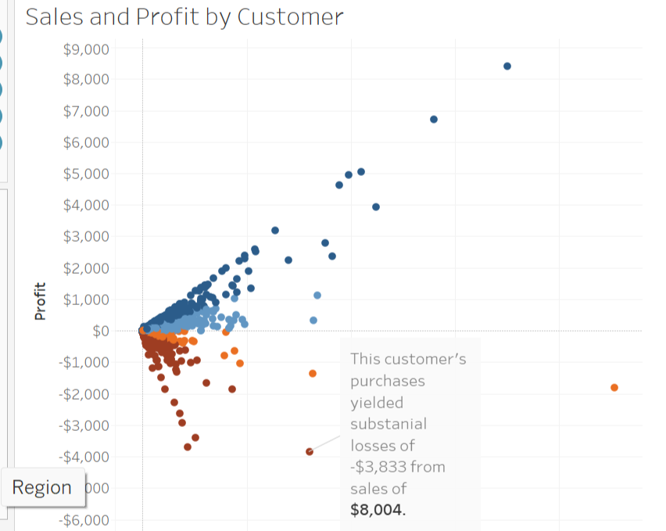
What is the Problem ?
Most of the customers earn us a profit but there are customers who have a “lot "of sales but yield a negative profit ….a loss !!
WHY ??

Slide 3
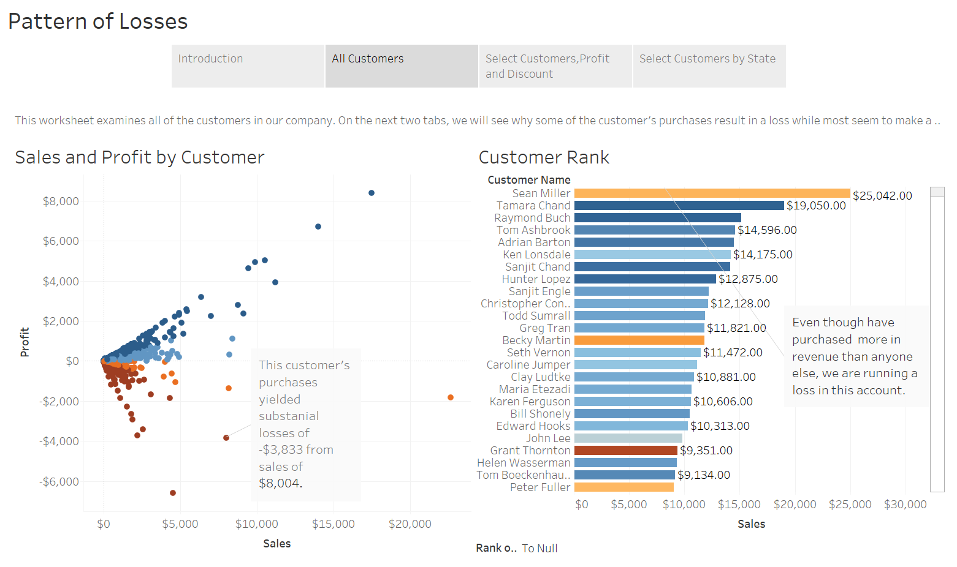

Slide 4
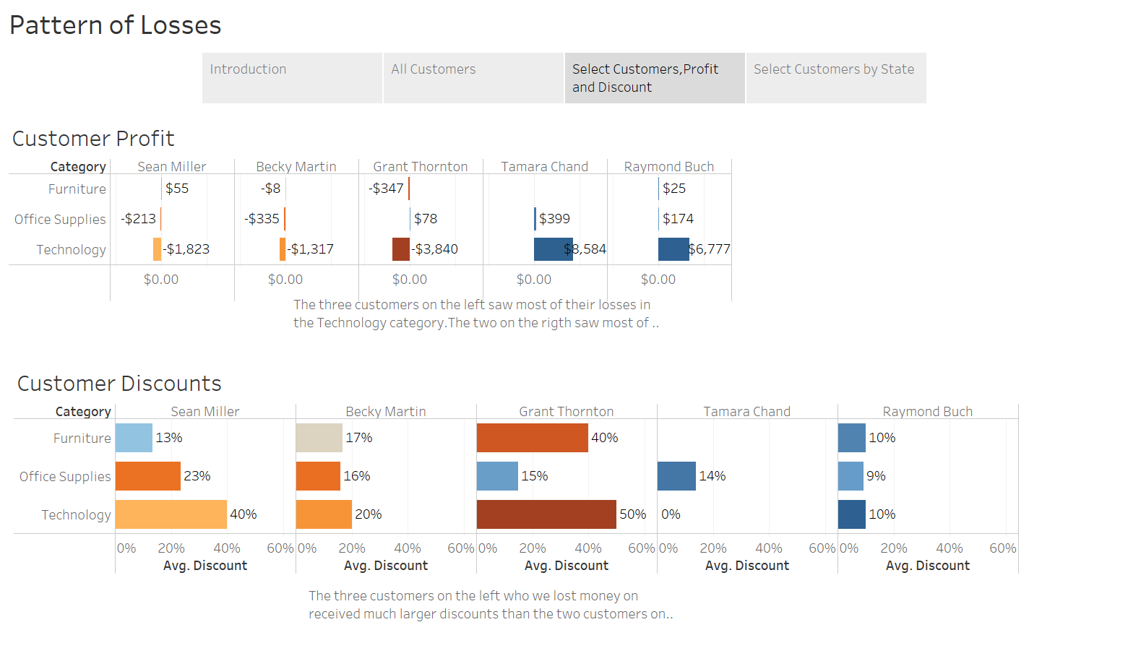

Slide 5
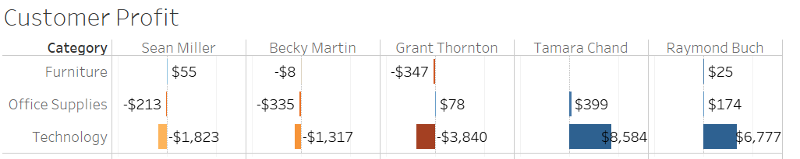
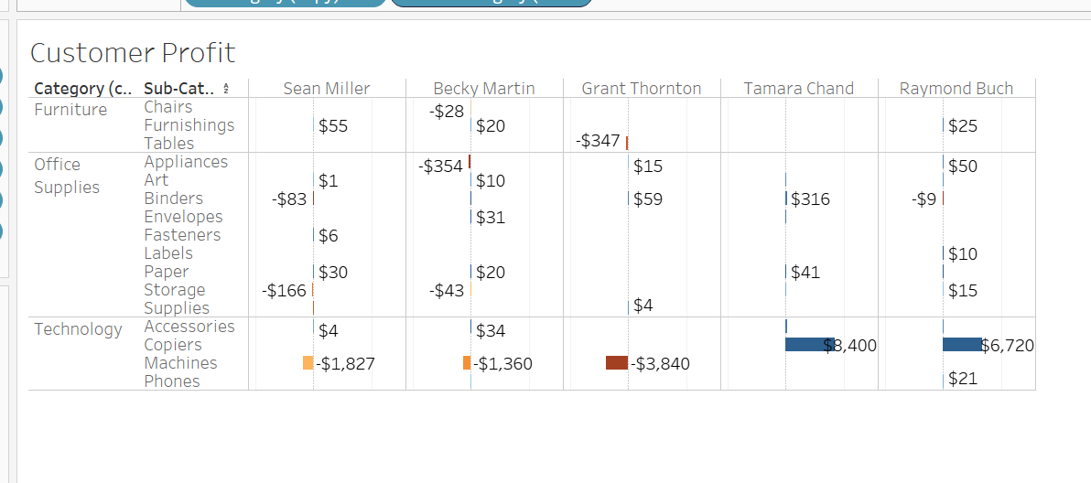
Its not the category but type of product that results in losses !!!!

Slide 6
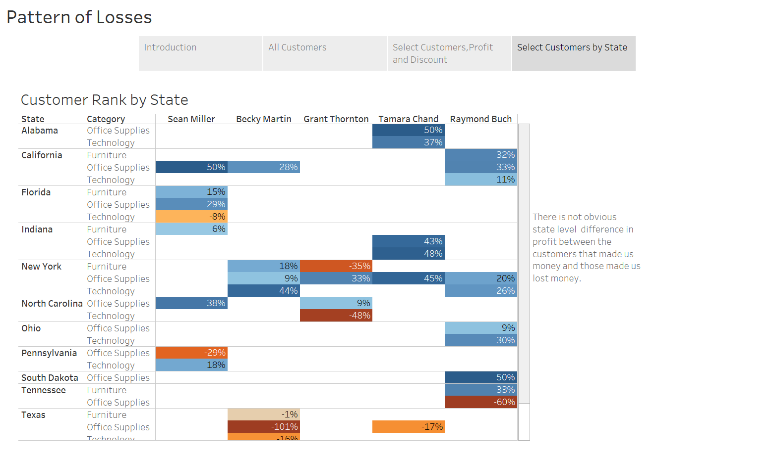

Slide 7
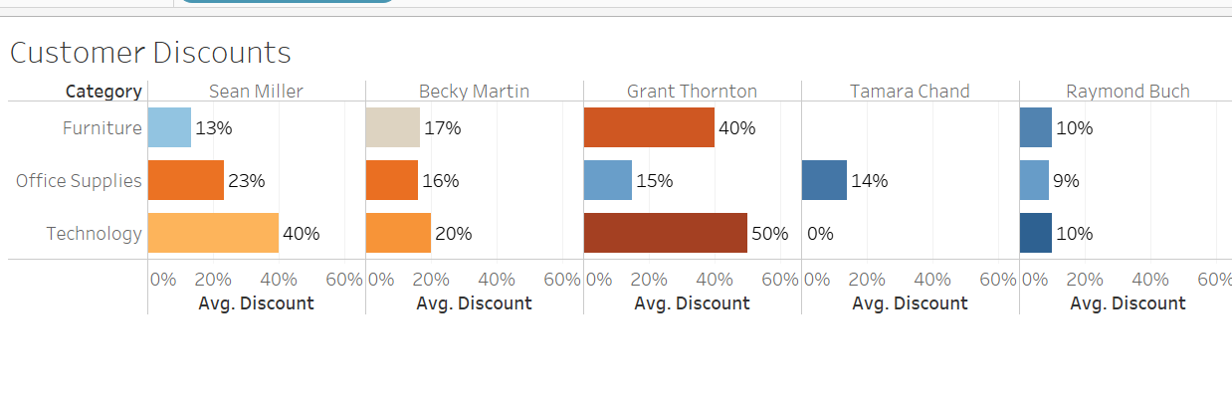
The level of discounts does play a role in profit and losses.

Slide 8
Conclusions and Recommendations :
Sales by state may have outliers but there doesn’t seem to be a pattern. Hence, I recommend not
studying geography as a reason for losses in the first round.
2. Copiers are profitable while machines are not. Consider options for addressing issues with machines.
It could be the pricing structure of the machines.
3. Some customers are receiving discounts on products well in excess of what is needed to maintain
profitability.

